Slide 1

Smart walker
Jackson Farley, Erik Leinen, Ellie Langley
ELC 4438 Spring 2019

Slide 2
Design Purpose
Elderly people who are living on their own desire independence, but they may require the assistance of a walker.
“As the numbers of elderly people continue to rise, the demand for walking aids is expected to increase two fold by 2050.”[Passary]
Elderly people are more likely to experience injurious falls according to the National Council on Aging: “One in four Americans age 65+ falls each year.”
These falls, particularly when an elderly person is living by themselves, can be dangerous for the person: “Falls are the leading cause of fatal injury and the most common cause of nonfatal trauma-related hospital admissions among older adults.”
To allow greatest degree of independence, a solution is interactive walker to monitor a person and accommodate their state of being
Notes:
Ellie

Slide 3
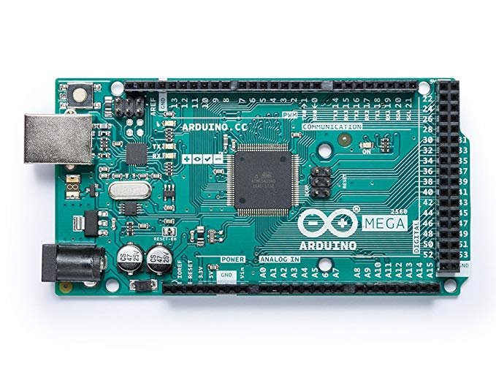
Hardware design
Notes:
Jackson

Slide 4
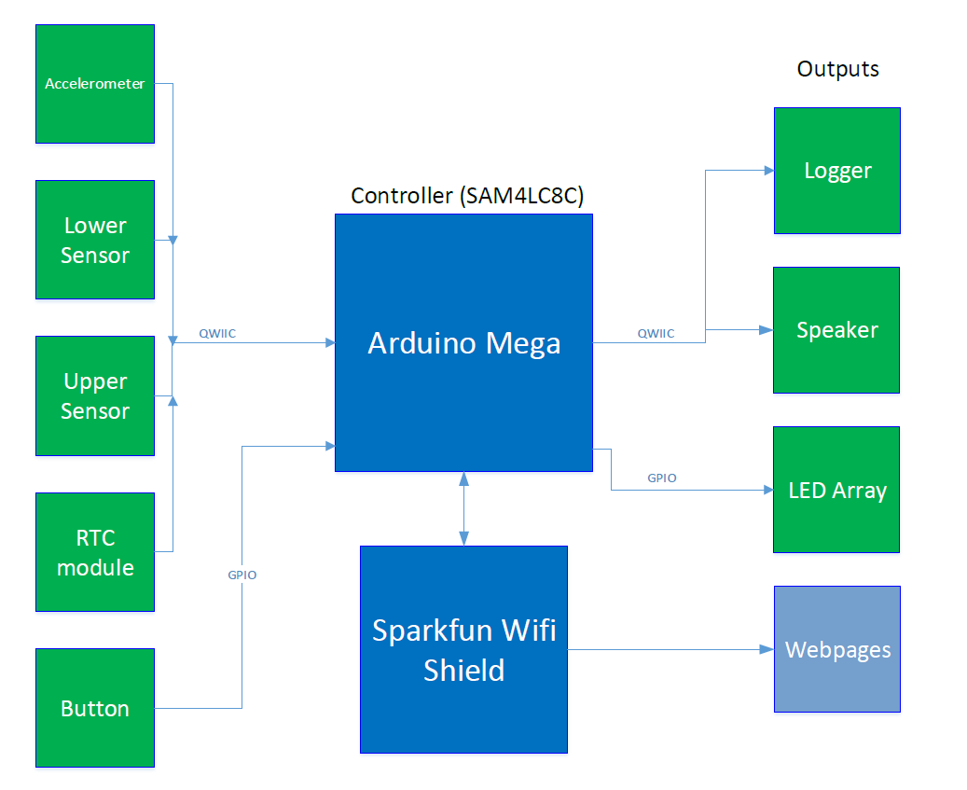
Block Diagram
Notes:
Erik

Slide 5
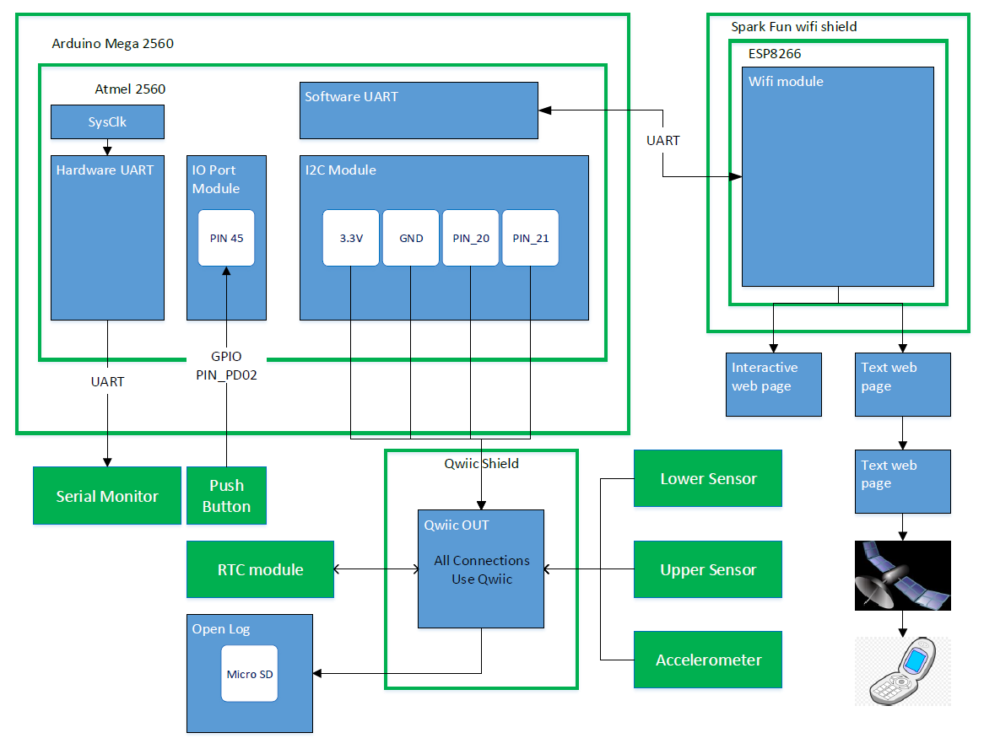
Functional Architecture
Notes:
Erik

Slide 6
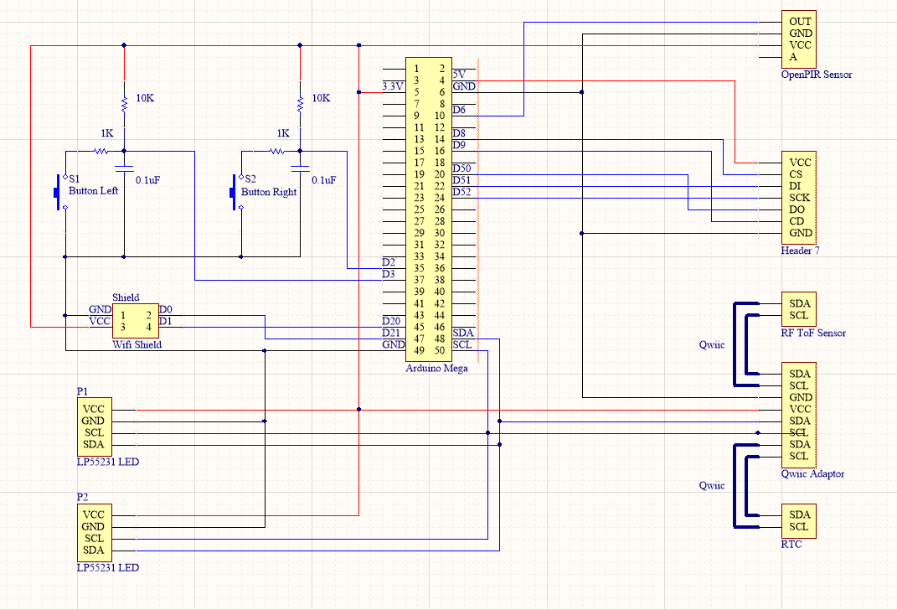
Final Schematic
Notes:
Erik

Slide 7
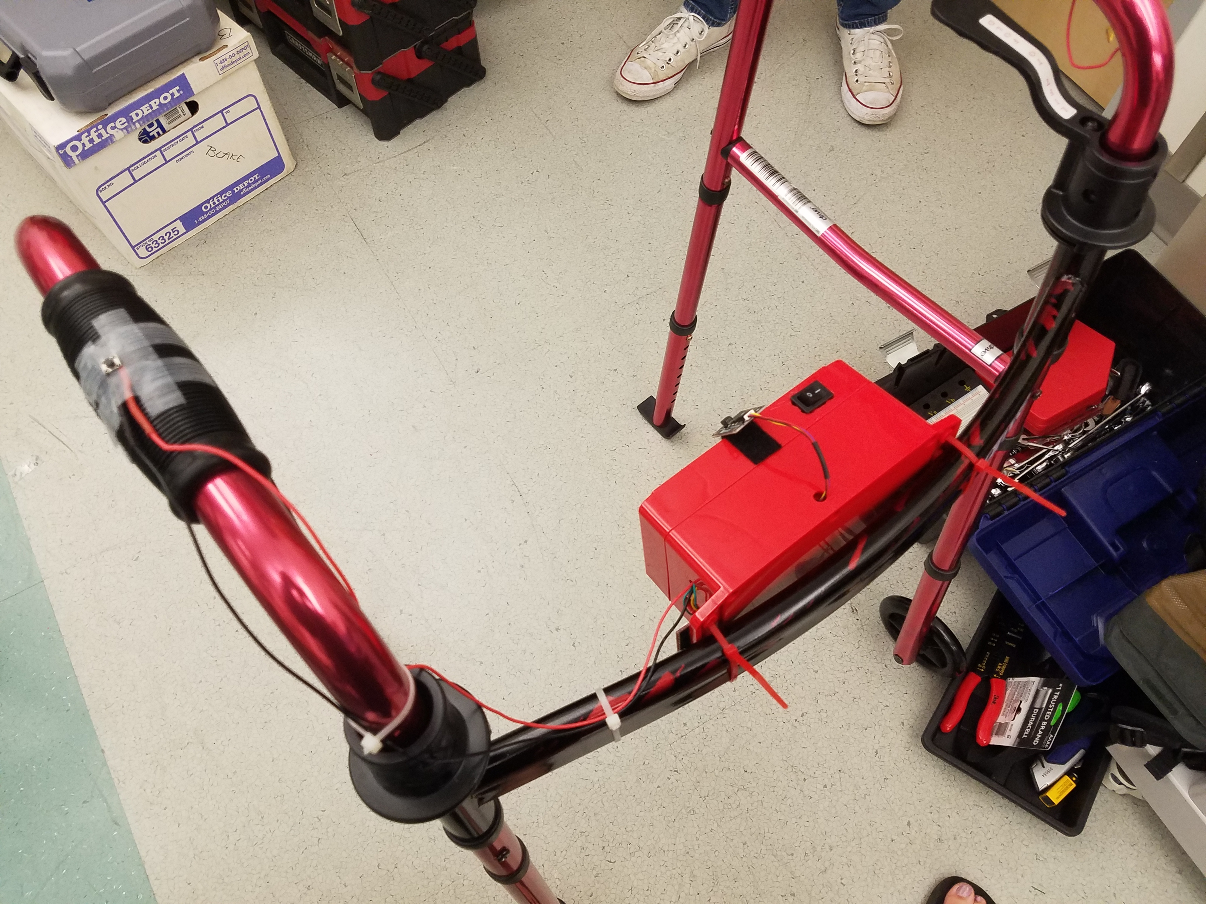
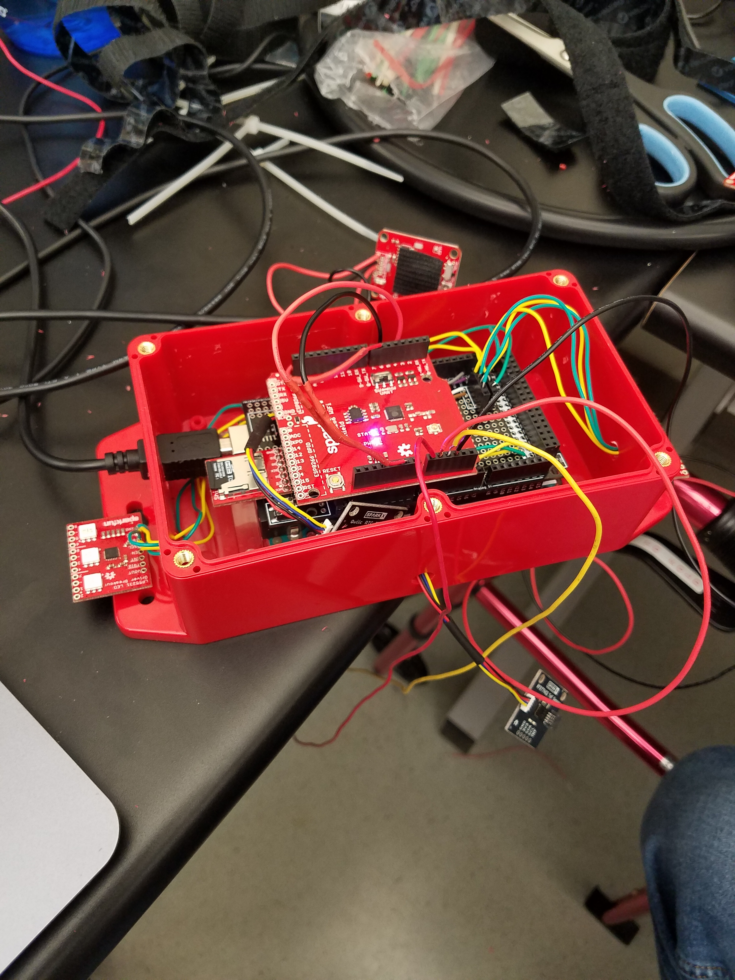
Integration
SENSORS
AND

Slide 8
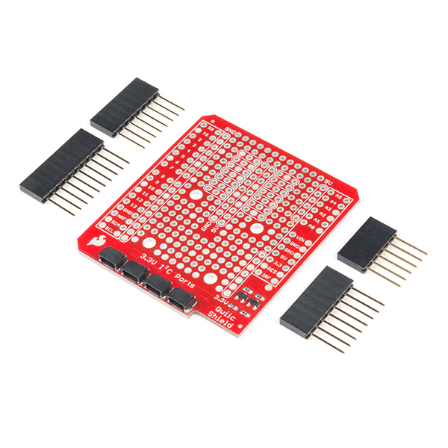
QWIIC Shield?
Connects to I2C bus on Arduino
Converts 5V power to 3.3V power needed for QWIIC I2C sensors
4 I2C ports for multiple sensors
Stackable!
However…
Notes:
Ellie

Slide 9
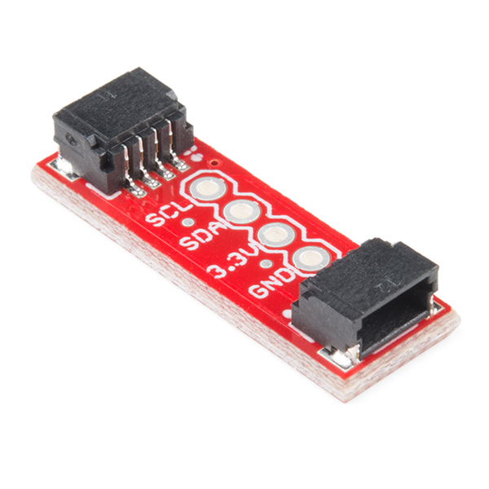
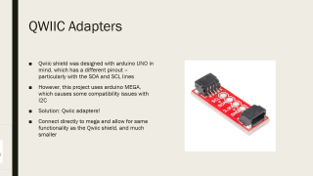
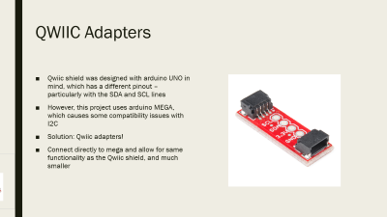
QWIIC Adapters
Qwiic shield was designed with arduino UNO in mind, which has a different pinout – particularly with the SDA and SCL lines
However, this project uses arduino MEGA, which causes some compatibility issues with I2C
Solution: Qwiic adapters!
Connect directly to mega and allow for same functionality as the Qwiic shield, and much smaller
Notes:
Ellie

Slide 10
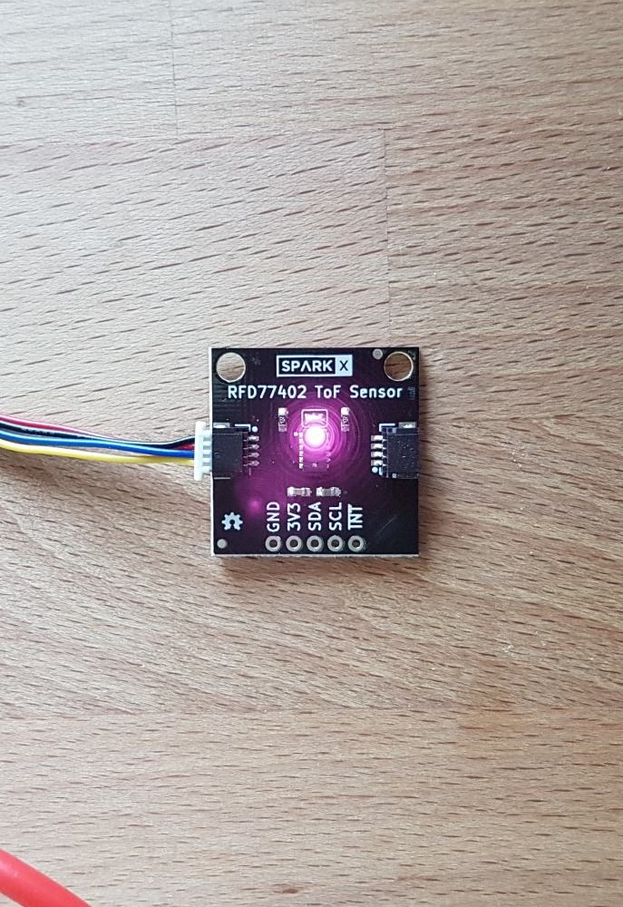
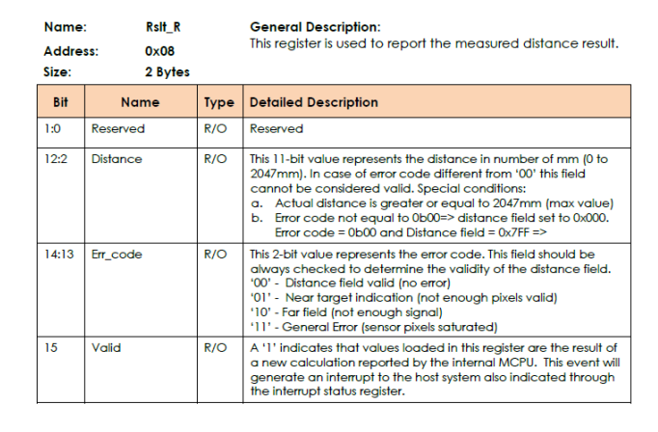
RFD7704 QWIIC Time of Flight Sensor
I2C sensor
Senses human presence up to 2 meters
Library readily available to be implemented in Arduino
8 bit, 16 bit addressing
Connected to QWIIC shield
Results stored in I2C address 0x08, 12:2 is distance
Configure address 0x00
Notes:
Ellie

Slide 11
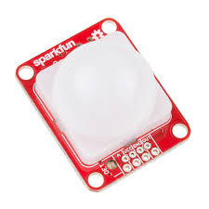
GPIOs
PIR Sensor
Digital input value changes upon sensing movement
HIGH when movement is detected
LOW when no movement detected
Can be powered by 3.3V or 5V
Notes:
Ellie

Slide 12
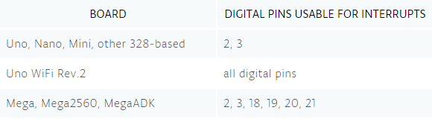
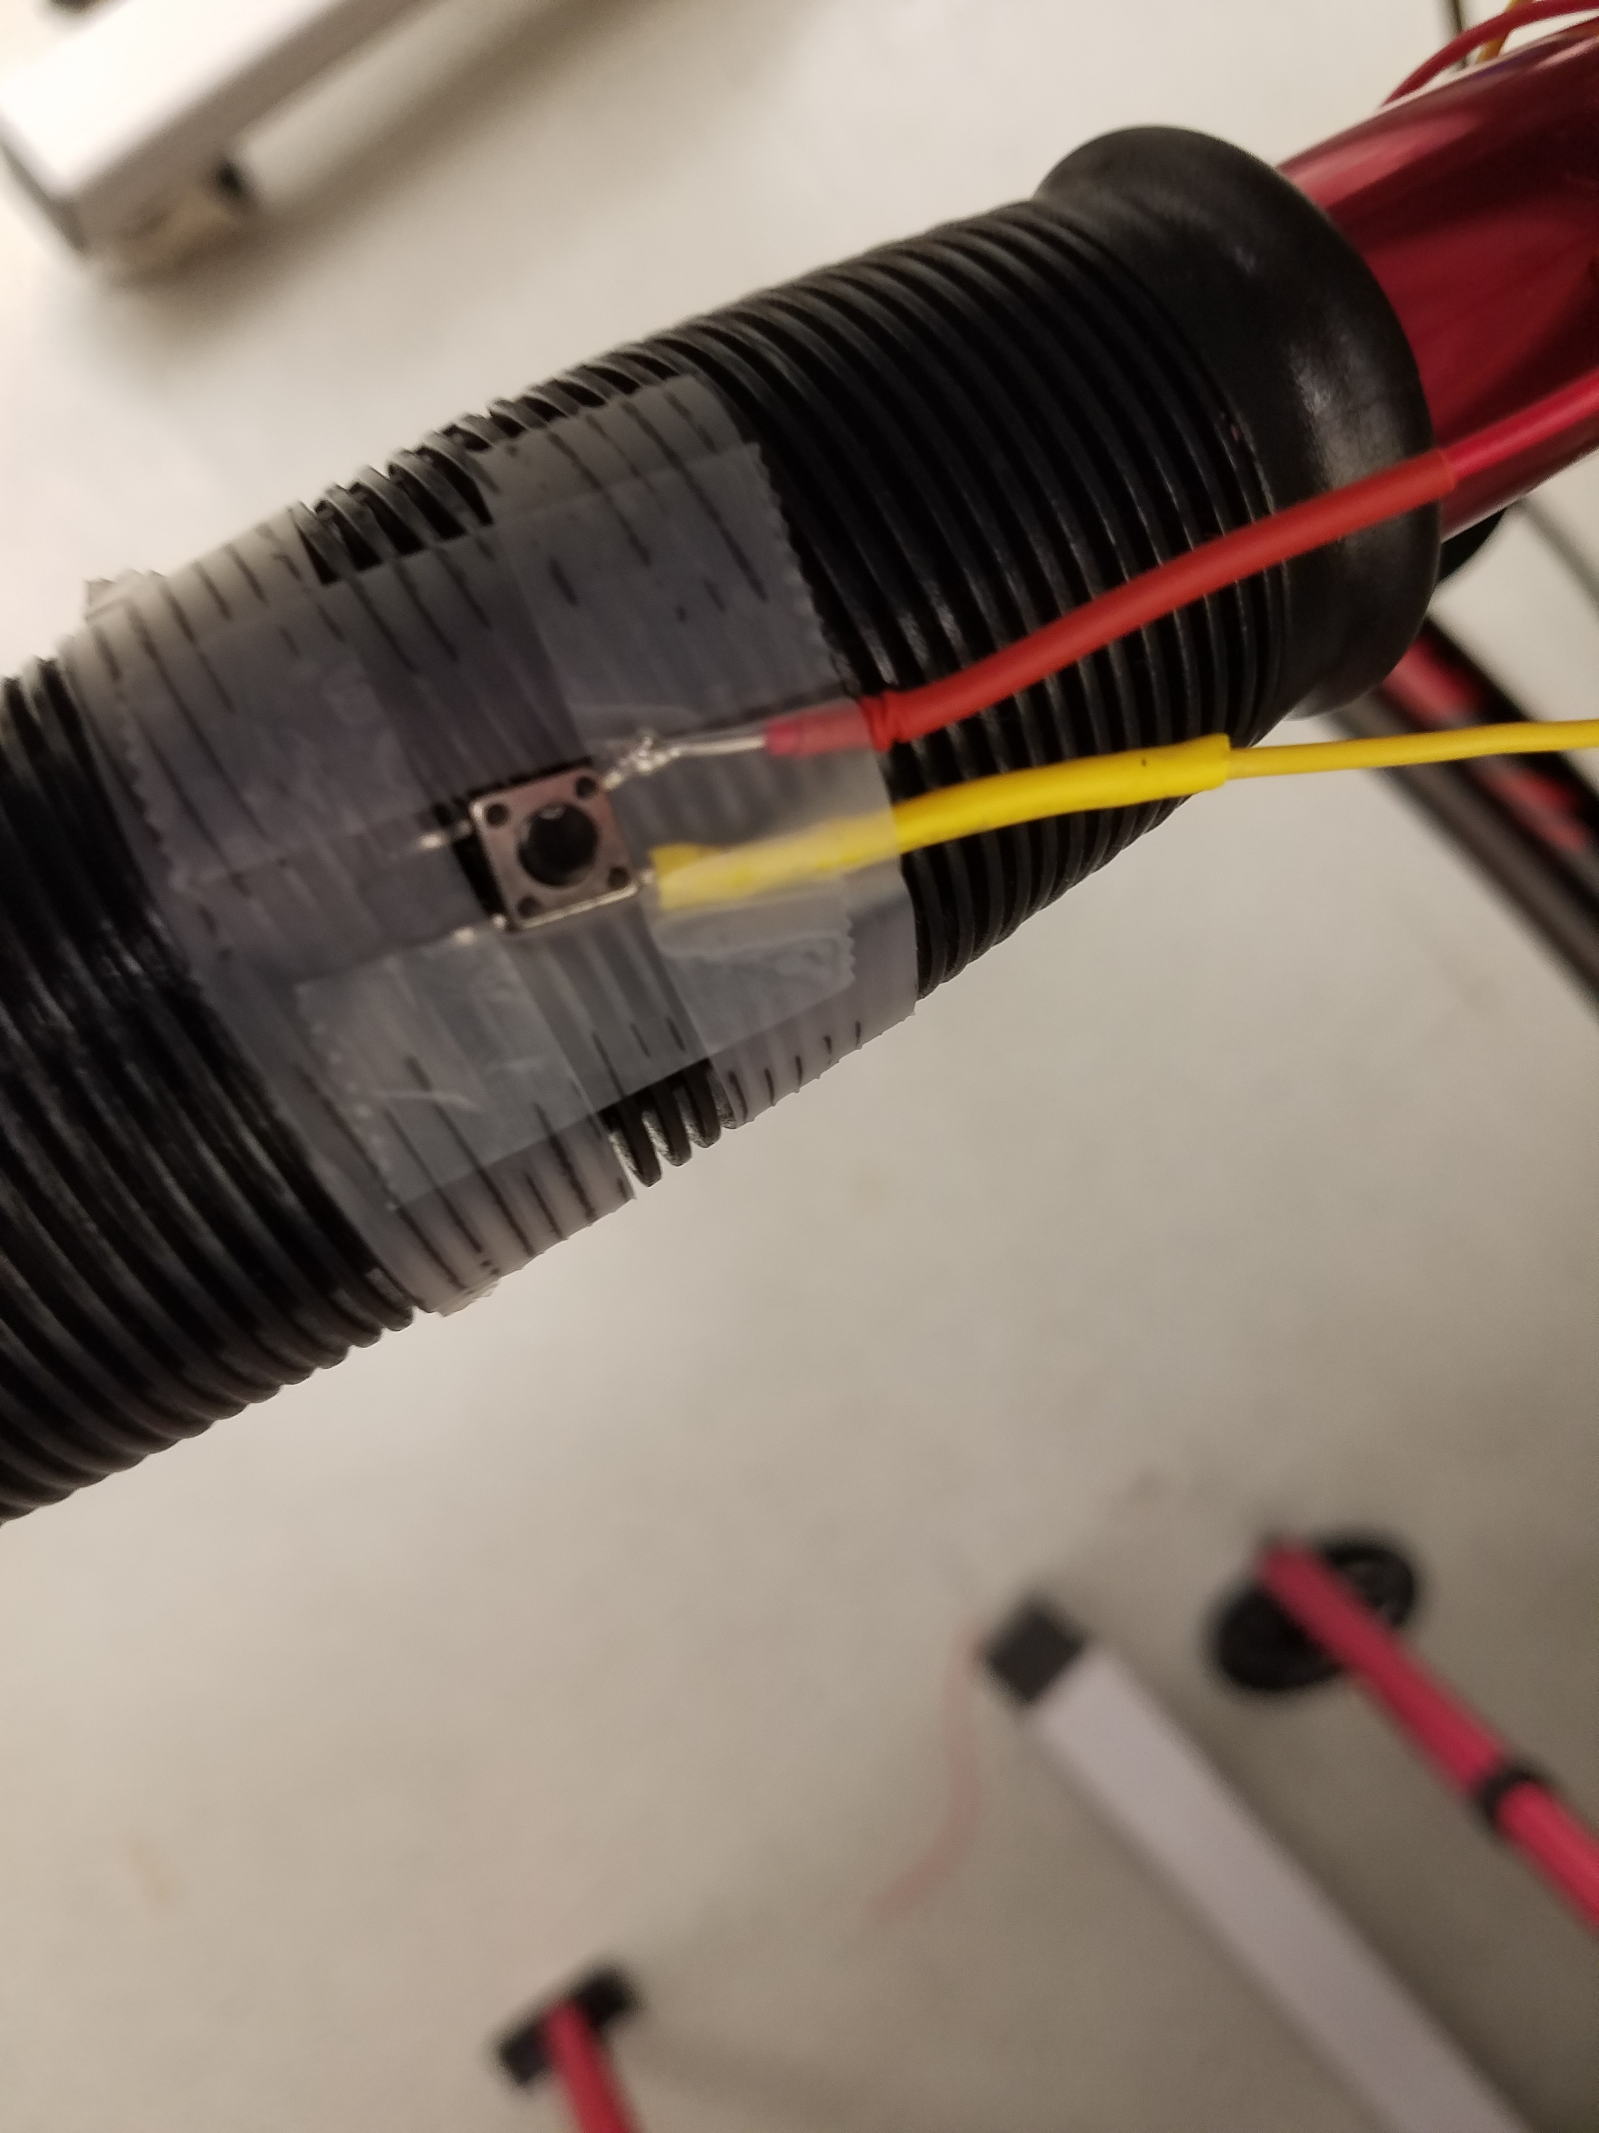
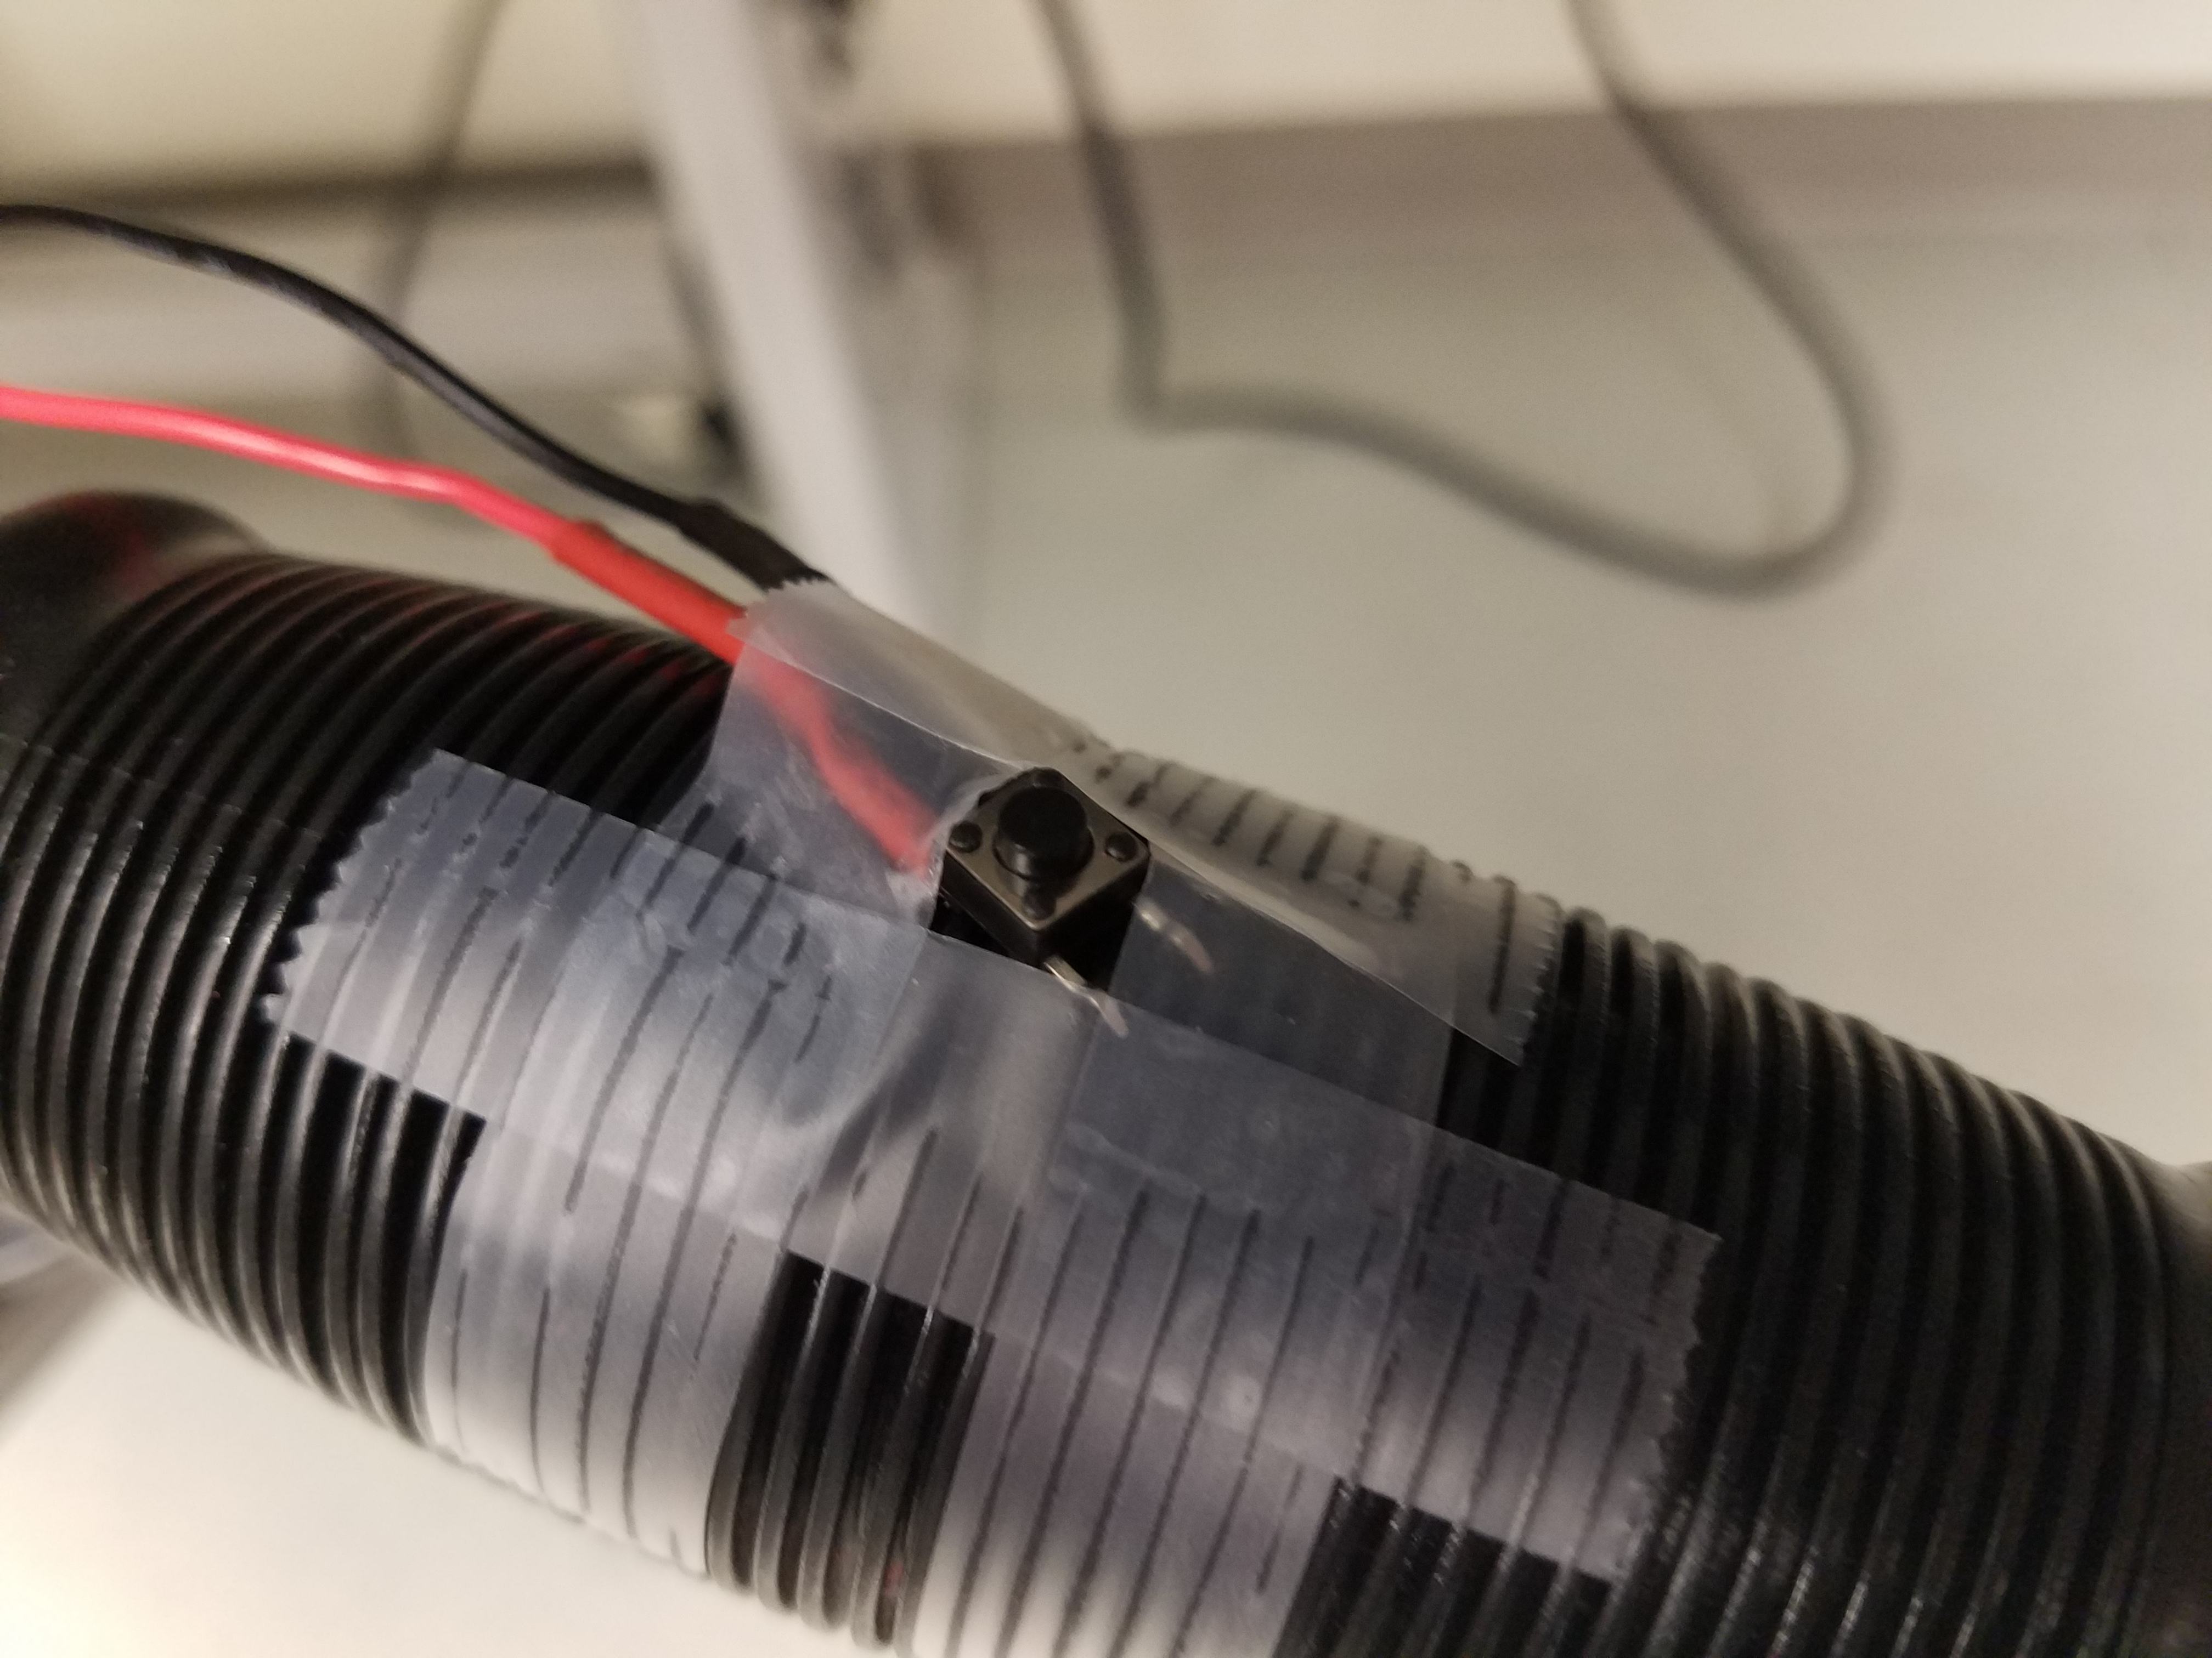
GPIO Interrupts
Two buttons – one on the left, one on the right. These are connected to interrupt pins on the Arduino mega and when pressed, trigger an interrupt as explained in activity diagram.
Basic pushbuttons
Attached to pins 2 and 3 of arduino mega, which are specifically interrupt pins
“attachInterrupt(DigitalPintoInterruptPin(pin), ISR, mode)”
Arduino maps the specific pins to the interrupt channels, so this increases readability
ISR – name of handler function when interrupt is triggered
mode – determines when interrupt will happen
LOW – interrupt happens when button is low
CHANGE – when button changes state
RISING – when button goes from LOW to HIGH
FALLING – when button goes from HIGH to LOW
Notes:
Ellie

Slide 13
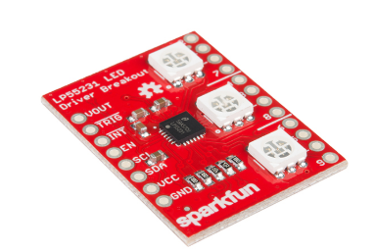
LP55231 LED Driver Breakout
LEDs controlled via serial bus
Library created to help with functions
9 LED channels, currently configured to drive three RGB LEDQ+
Master sends seven bit chip address, with eighth bit being READ or WRITE
Second byte selects register to write data
Third byte contains data to be written
Use to set current, control LEDs
Notes:
Erik

Slide 14
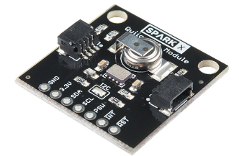
QWIIC RTC Module
Qwiic I2C interface
Real time clock accurate to within three minutes
Notes:
Erik

Slide 15
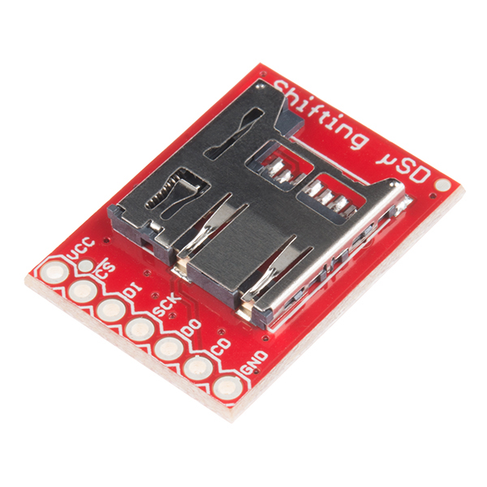
Sparkfun Shifting SD
Micro SD card at top power in arduino
Allows to mass storage
Holds information for time stamp
Notes:
Erik

Slide 16
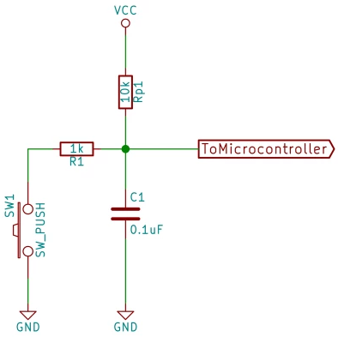
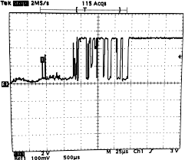
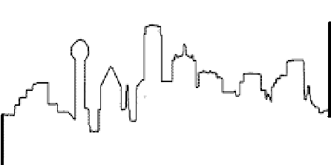
Debouncing
A large source of error was multiple interrupt calls on the rising edge of the Buttons
Could throw off state machine or cause unnecessary writes
Hardware Solution:
Debouncing with resistors and capacitors
Software Solution
Also make the state that the interrupt points to persist longer
Actual Scope Image ->
Notes:
Jackson

Slide 17

software
Notes:
Jackson – pull up code in new tab

Slide 18
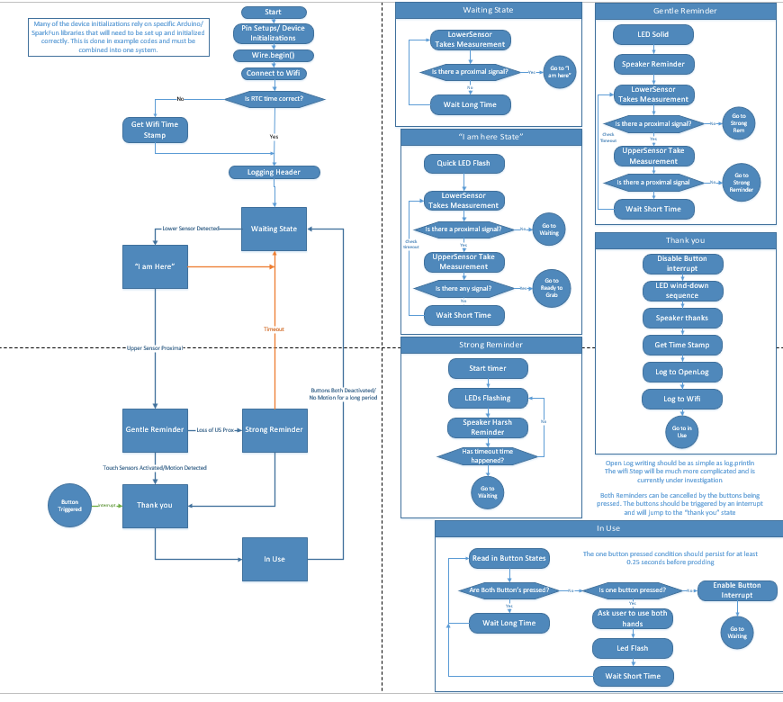
Activity Diagrams
Activity Diagram Link for higher quality look: link
Notes:
Jackson

Slide 19
State Machine
Various states written into the code so that the system will execute functions depending on those states
“WaitingState”
“iAmHereState”
“InUseState”
“ThankYouState”
Notes:
Jackson

Slide 20
Timing
There is a specific Blynk Timer that we used instead of delay()
This allows for other functions in the loop and the wifi to continue to run efficiently
Have separate timer intervals for the state machine to run as well as the led function
These have internal calculations and a static int that allows for the calculation of time inside the function.
Notes:
Jackson

Slide 21

Code Walkthrough
With Your Hosts,
The SmartWalkerTeam

Slide 22
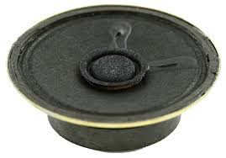

Future Plans
Better wifi modularity
Soft access point
Rechargeable batteries
Better case – 3-D printing in future?
Speaker – in original design, but did not have a speaker to implement
Adaptive LED lighting
Add 2 hand reminders
If one hand is off the walker, have the walker gently remind the user to use both hands
Notes:
Ellie

Slide 23
Sources
Statistics on the elderly: https://www.ncoa.org/news/resources-for-reporters/get-the-facts/falls-prevention-facts/
Pictures of sensors, datasheets: https://www.sparkfun.com/
Information for arduino interrupts: https://www.arduino.cc/reference/en/language/functions/external-interrupts/attachinterrupt/

Slide 24

Questions?

Slide 25


Slide 26


Slide 27
Wifi integration

Slide 28

Blynk
This is a potential wireless interface that we would like to work with more in the future.
Via the wifi shield, the Arduino should be able to communicate information to a phone or webpage and have its own app.
Could allow for tracking of smart walker use and effectiveness of the walker program
Currently a work in progress

Slide 29
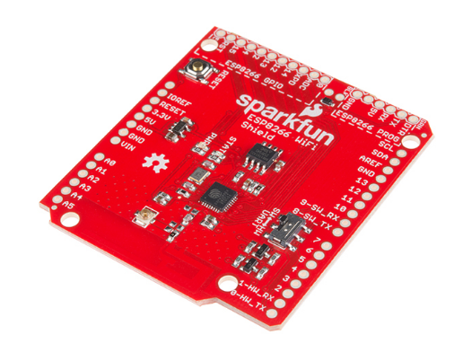
ESP8266 Wifi Shield
Stacks on top of QWIIC shield
Creates log of walker usage

